Slide 1
Service Orchestration in Arrowhead -- G3.2 and beyond –
Csaba Hegedűs (hegeduscs@aitia.ai)
Pál Varga
AITIA Inc.
Budapest University of Technology

Slide 2
Agenda
What is it designed for?
Requirements and scenarios
Principles
G3.2 orchestration
Intra-Cloud orchestration fundamentals
Inter-Cloud orchestration concepts, philosophy
Inter-Cloud core architecture
Future work
Where to next?
Optimization of the framework

Slide 3
Orchestration in various domains - RECAP
 | Orchestration | Security | Protocol stack | Implementations
Web Services | - orchestration: service composition at provider side - choreography: macro-lensed configuration of components for a specific target | - SSL/TLS using X.509 hierarchy - advanced authorization based on roles | -transfer: HTTP -data representation: mainly XML | - Java EE - Microsoft .NET Framework - DWPS
IT Clouds | - configuring cloud resources for service deployment - monitoring of deployment (telemetry) - event and error handling - policy-based orch. | - orchestrators configure security measurements - VPN solutions - Virtual Network Functions run by physical devices | - various, some based on e.g. HTTP | - IBM SmartCloud Orchestrator - Intel Ciao - Apex Lake
Software Defined Networking | - coordinate network resources and actives for new services - deployment of network virtual functions - deployment monitoring (QoS) |  | -various - OpenFlow - OpenStack
Formalized orchestration languages | - process control-flow description and verification | Not involved | - scripting languages (e.g. Java-based) | - Chor - ChorEvolution
Notes:
Also:
We have to differentiate between private data and that of public interest.
We have to protect the systems that provide such data approprietly.

Slide 4
Useful concepts here and there and their possible limits
 | Useful concepts | Inadequacies
Web Services | - applicable protocol stack - orchestration and choreography solutions | - large protocol stack overhead - only HTTP and XML - no real-time QoS capabilities
IT Clouds | - architecture for central governance of deployments - reconfiguration methodologies - performance monitoring, event detection techniques (telemetry) | - Instrumentational toolsets are connected to cloud and network resources - Requires advanced end-point capabilities - suited for infrastructure management
Software Defined Networking
Formalized orchestration languages | -scripting languages - evaluation methodologies | Mainly proof-of-concept

Slide 5
Our definition of Orchestration
Primary high level target:
Tell App. Systems what Services to consume and from where
There shoud be both:
on demand (upon request)
a central push (initiated by central governance):
Secondary, implied targets:
General management/ governance of the Local Cloud
Provide reconfigurability of the SoS for operators
Manage resources, their utilization (network and hardware QoS)
There should be a layer for process engineers to plan their operations and enforce that new working order on the CPS-s.
Arrowhead meta-layer: protocol independency
Also provide translation if possible/necessary

Slide 6
App. System autonomy levels
We should be able to facilitate App. Systems of increasing intelligence and self awareness.
They should be able to co-exist in an LC.
Passive Service Providers
Only offer certain Services in limited number of interfaces.
Only have to register in the SR
Only have to respond to inbound connections, with proper AAA (preferably pre-rendered)
Its resouces might have to be managed centrally (QoS: e.g. # of paralell inbound connections)
Statically pre-configured Service Consumers
The App. System only consumes a pre-defined (hardwired) set of Services
There might be multiple configuration modes (sleep, active, etc.)
There is a list of hardwired Service Providers it is supposed to consume from
Only needs the Orchestration Store

Slide 7
App. System autonomy levels II.
3. Service Consumers with statically configured Service Providers
Same as (2), but each Service might have backup Providers defined
The Orchestrator might be asked to locate an available Provider based on a pre-set priority list stored in the Orch. Store
Controllers can only access a specific temperature sensor, but there might be backups for that sensor
4. Fully autonomous Service Consumers
System knows what Services and when it wants to consume.
Orchestrator’s task is to locate appropriate Provider with selection criteria submitted by the requester Consumer
E.g. electromobility use case in Arrowhead
5. Self-orchestrating Systems
Implement all Core Service interfaces (SR, Auth, GK, QoS Mgr) and capable of running self-orchestration, choice between possible Service Providers
Central management of resources and AAA might be still required.
High level functioning systems

Slide 8
App. System autonomy levels III.
6. System-of-Systems Configurators, Choreographers, Plant Description Engine
Via HMI: human operators
Capable of configuring the SoS, through the Core Framework
Process engineering tools (similar to LabView or Matlab Simulink?)
Should utilize „push” Orchestration/Reconfiguration capability through the Core Systems to enforce the new working order
Further develop the Plant Description (see later)

Slide 9
App. System security levels
No security
Resource constrained AA (~ticketing)
Certificates, without transactional authorization
Certificate with authorization tokens
App. Systems with built in authorization (self admission control)
We need handovers and interoperability between these different types.

Slide 10
Deployment environments of the Framework
Based on the known (project) use cases: (sketch)
Production floor scenarios (factory automation)
Real-time QoS, etc.
Across the production chain
Multiple vendors, systems are advanced (ERP, data center, etc.)
AAA is essential, and should be centralized inbetween companies
Market-like scenarios
Virtual market of energy; electromobility
App. Systems enter and leave; servicing is transactional/one-time only
Offered and looked up Services vary over time
The Orchestrator has to provide advanced matchmaking based on a multitude of metadata
Big data, cloud processing, CPS-s, WSN-s, etc.
Like the MANTIS project
Processing entity in the cloud; sensing, actuating, storing locally
Company policies, use case dependent architecture: local and global clouds cooperating

Slide 11
Therefore… (requirements engineering)
The Orchestration Service has to be:
Modular and its sub-processes optional for most part
It should be tailorable by the LC developer/operator (via the Orch. Store)
It should be tailorable by the Consumer (I am looking for a …)
Should have a simple interface (request-response)
Unified data structures, one message body
Request: small mandatory part, but custumizable
Should try to be protocol independent
There might be:
Hardwired connections (Orchestration Store)
Ad hoc, dynamically orchestrated Services
We need an architecture that allows for centralized and decentralized governance of an LC

Slide 12
G3.2 orchestration features and concepts

Slide 13
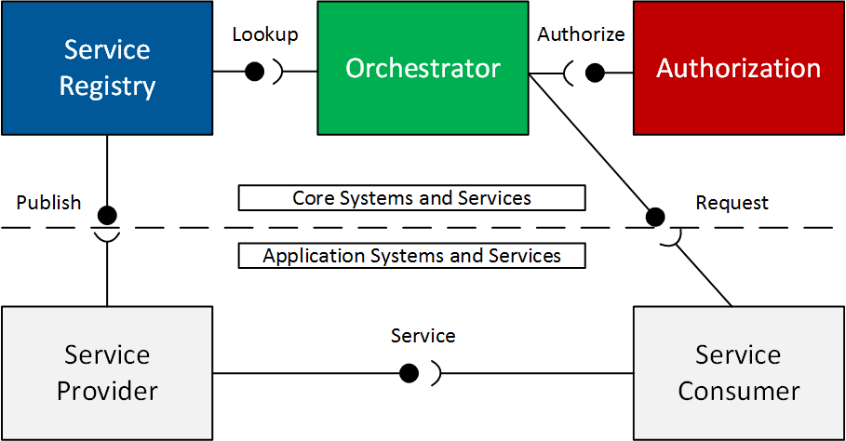
G3.2 Core Framework
Minimum working set
Advanced working set (G3.2 and beyond)
Notes:
Introduction and goals of AH
Local Clouds work in SOA.
There are the mandatory core systems, that offer basic governance.
Authorization now bears two tasks: access control information, token gen.
SR: now capable of cleaning up the database, implements service metadata with every offering separately.
Gatekeeper has two services: GSD, ICN.
Network Manager will be required to build up inter-cloud data end-to-end path.

Slide 14
The current G3.2 Orchestrator (Milestone 2)
Used terminology: intra- and inter-Cloud orchestration
Consists of two modules:
Orchestration Store (private, inner interface)
Matchmaker logic (public)
Offers one public Service:
Orchestration Service (not Orchestration Store Service)
Request-response based (currently JSON)
Service Request Form
Orchestration Response (List<OrchestrationForm>)
Capable of 3 orchestration types within one Service:
Default configuration (for booting of App. Systems)
Store-based orchestration (with a backup list of Providers for a given Service for a given Consumer)
Dynamical orchestration
In the latter two, inter-Cloud orchestration is included if necessary

Slide 15
Orchestration Service

Slide 16
Reminder of the common descriptors within G3.2

Slide 17
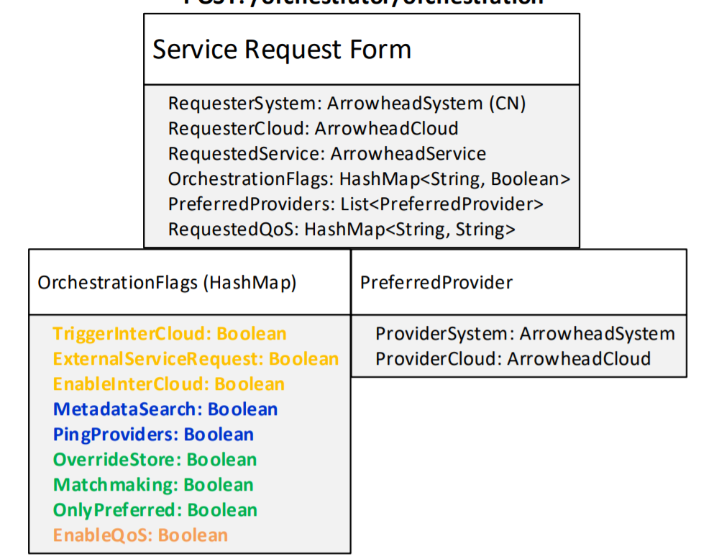
Service Request Form
Identity of the Consumer, mandatory
Requested Service (optional)
Preferences of the Consumer (dynamical orch.)
Flags that can be set by the Consumer to configure the Orch. Process
All of them are optional, by default False.
QoS, demonstration only

Slide 18
Orchestration Response
The to-be-consumed Service (up to IDD)
The Response entity contains multiple Orchestrations.
The Provider’s identity (IP:port/baseURL)
The URL of the Service (after baseURL)
Token and signature (optional)
Special field that can pass extra configuration data serialized.
Currently only used by the „Default Config”.

Slide 19
Default configuration (boot time)
For App. System initialization
Static, Orchestration Store entry
Service Request: minimal
If SSL is used, could be reduced to a GET (not implemented)
Orchestration Response
There can be additional configuration information passed („Instructions”)
An ordered list of <Provider, Service, Instruction>
Intention:
Firstly, you shall consume the „System Configuration Service” from SysConfig Store
Secondly, consume the „ServiceDiscovery Service” from SR to register yourself
Thirdly, consume again the „Orchestration” with a runtime request (passed in the Instruciton field)
Notes:
A legalapvetőbb orchesztrációs módszer a legbutább rendszereknek az, hogyha felébrednek és megkérdezik mit kell csinálni.
Itt gondolhatunk arra, hogy az ábrán mutatott
Attól függően, hogy milyen képességekkel rendelkeznek az alkalmazási rendszerek (szenzorok → okos eszközökig), különféle orchesztrálási módszereket kell alkalmaznunk. Azonban ezeket egy szolgáltatásba összegyúrva, ??.

Slide 20
Store-based Orchestration (runtime)
For runtime. There are hardwired connections with possible backup Providers.
The Orchestrator will return the highest priority one that is:
online (PingProviders), currently authorized, satisfies QoS, etc.
For runtime; with integrated exception handling: re-orchestration (pull)
Dynamical and inter-Cloud orchestration is embedded within this type of Store entry, if necessary
Notes:
It is good for creating backups, if a SP dies or not available anymore. Increases robustness.

Slide 21
Dynamical orchestration
Finding an appropriate Provider (intra- or inter-Cloud) based on:
Service and its metadata (from SRF)
Preferences of the Consumer (from SRF)
Requested QoS (from SRF)
Currently available Providers and neighborhood Clouds

Slide 22
Flags, flags, flags…

Slide 23

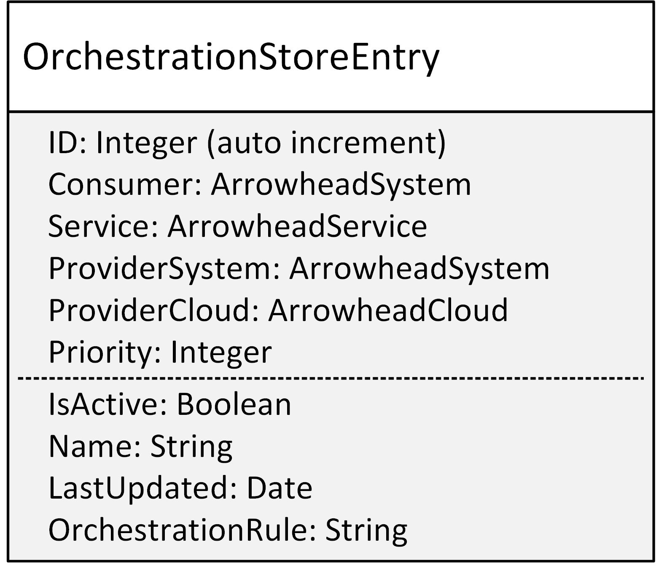
Orchestration Store
To-be consumed Service and Service Provider (and its Cloud);
Instruction for Consumer.
Consumer ID
For maintenance.
Default config?
Priority of entry (Store-based)

Slide 24
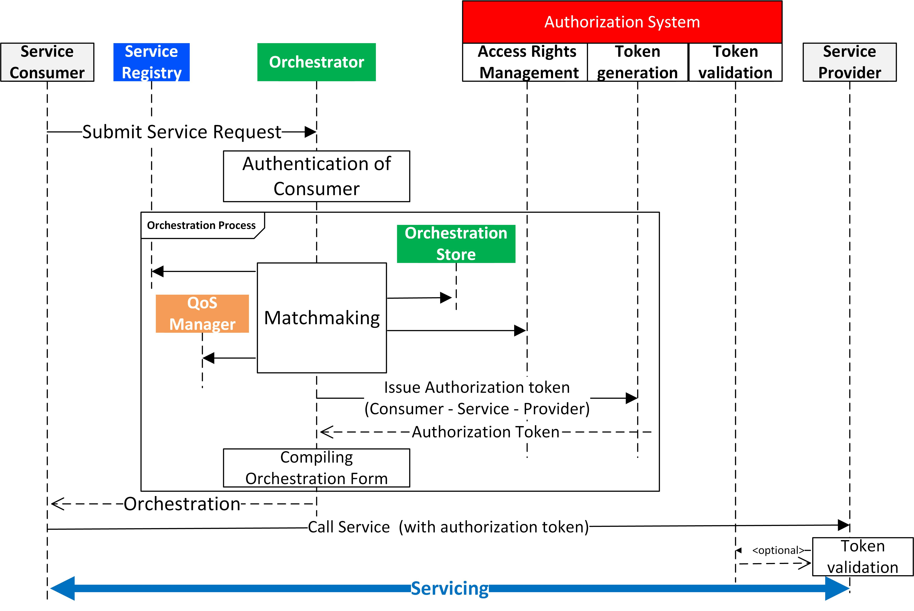
Token in the local orchestration process

Slide 26
Intra-Cloud conclusions
The Orchestrator’s internal working can be tailored.
By the developer (open sourceness)
By the operator (Orchestration Store)
By the App. Systems (OrchestrationFlags)
The MATCHMAKING algorithm can also be customized (i.e. dedicated functions within the code)
Can utilize other Core Systems (but not mandatory!)
AAA is/can be embedded (e.g. no SSL →with SSL→with token)
All based on Service metadata
Can support multitude of App. System intelligence
Dumb devices
Smart devices
Decentralized operations
Can be interface backwards compatible (TODO)
With a limited functionality, and based on the implemented implicite DNS naming convention:
sysName_sysGroup._afh-serviceName_serviceGroup_inteface._tcp.cloudName.operator.arrowhead.eu

Slide 27
Inter-Cloud servicing architecture

Slide 28
Inter-Cloud servicing
Fundaments:
Local Clouds are autonomous and independent from each another
Within an LC ther can be decentralized governance (minimal Core System functionality) or strict centralization -- from the outside, we don’t care!
But inter-Cloud requires that there are central entities responsible:
security: admission control (letting in external Systems) and AAA!
creation of the data path inbetween Clouds: Gateway, Firewall exception
App. Systems should not be bothered with every inter-Cloud request
Therefore:
During inter-Cloud orchestration, the 2 sets of Core Systems are negotiating.
It is completely transparent for App. Systems
Technical analogy: roaming in telecommunication

Slide 29
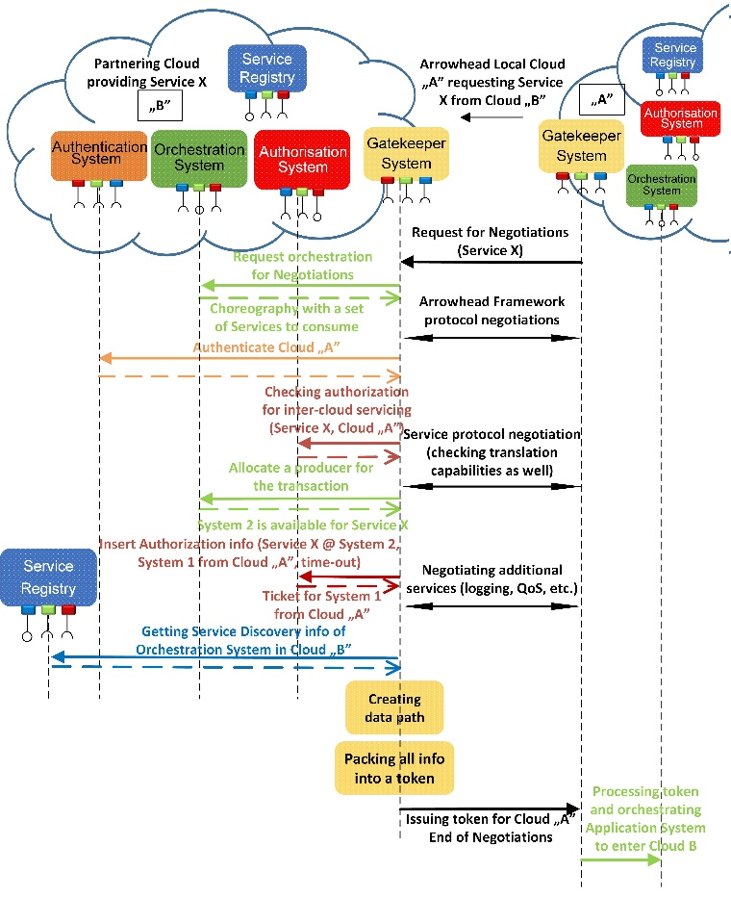
The Gatekeeper Services
Inter-Cloud Negotations
Preparing the servicing and negotiating the terms
Global Service Discovery
Initiated by the Orchestrator of the original LC
To locate Clouds where the service is currently available for us

Slide 30
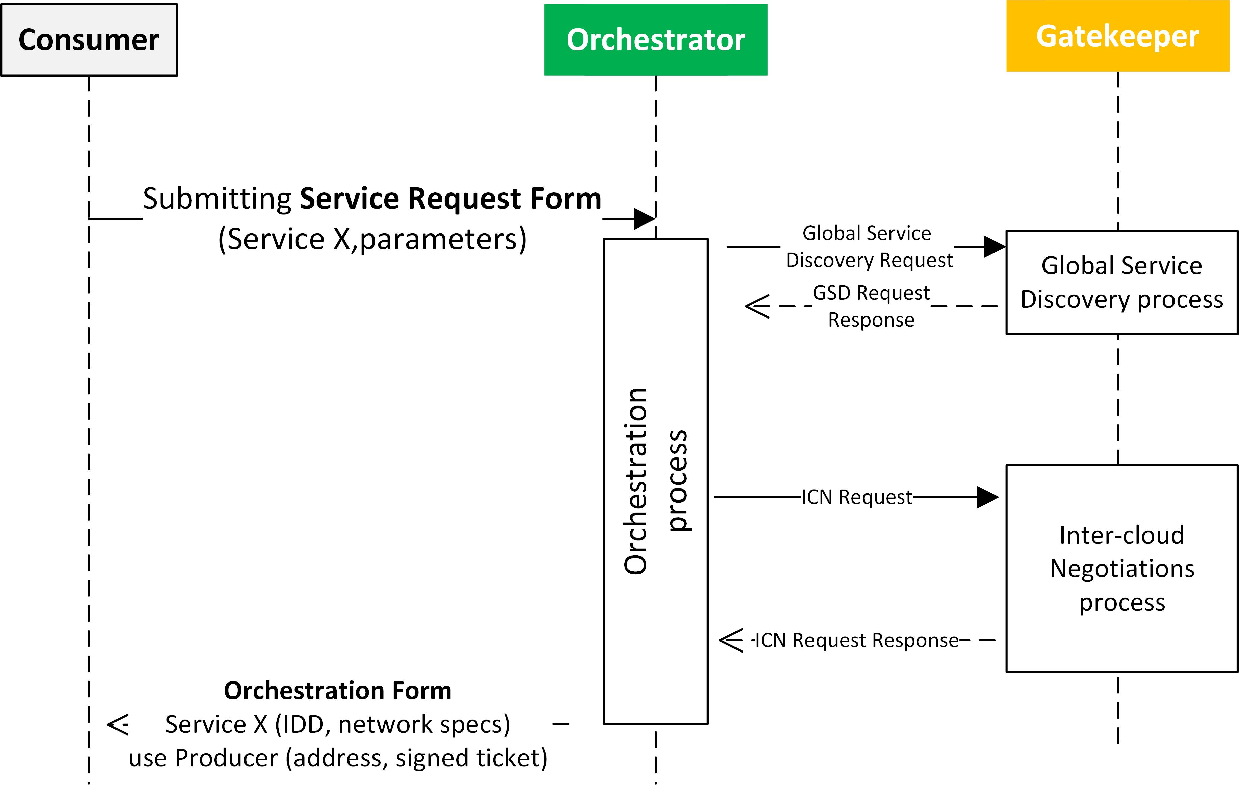
Inter-Cloud orchestration process (from the inside)

Slide 32
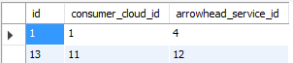
Inter-Cloud authorization
The Authorization System has a list which other LC is authorized to use which service from our LC.
AuthorizationControl service extended
This can be further developed.
Currently static rules.
Should rely on corporate contracts.
ArrowheadCloud
ArrowheadService

Slide 33
Arrowhead Inter-Cloud architectures
How to realize the Global Service Discovery functionality?
Which (other) Local Clouds do we ask when GSD?
How do we know them („discover the neighborhood”)?
We proposed three architectures:
Completely closed Arrowhead Neighborhoods
(Production plants)
Peer-to-peer ad hoc detection of other Local Clouds
(moving cars along the road, looking up local infrastructure)
A cloud-of-clouds entity handling the interactions between Local Clouds
(integration along the supply chain)
(supply and demand)

Slide 34
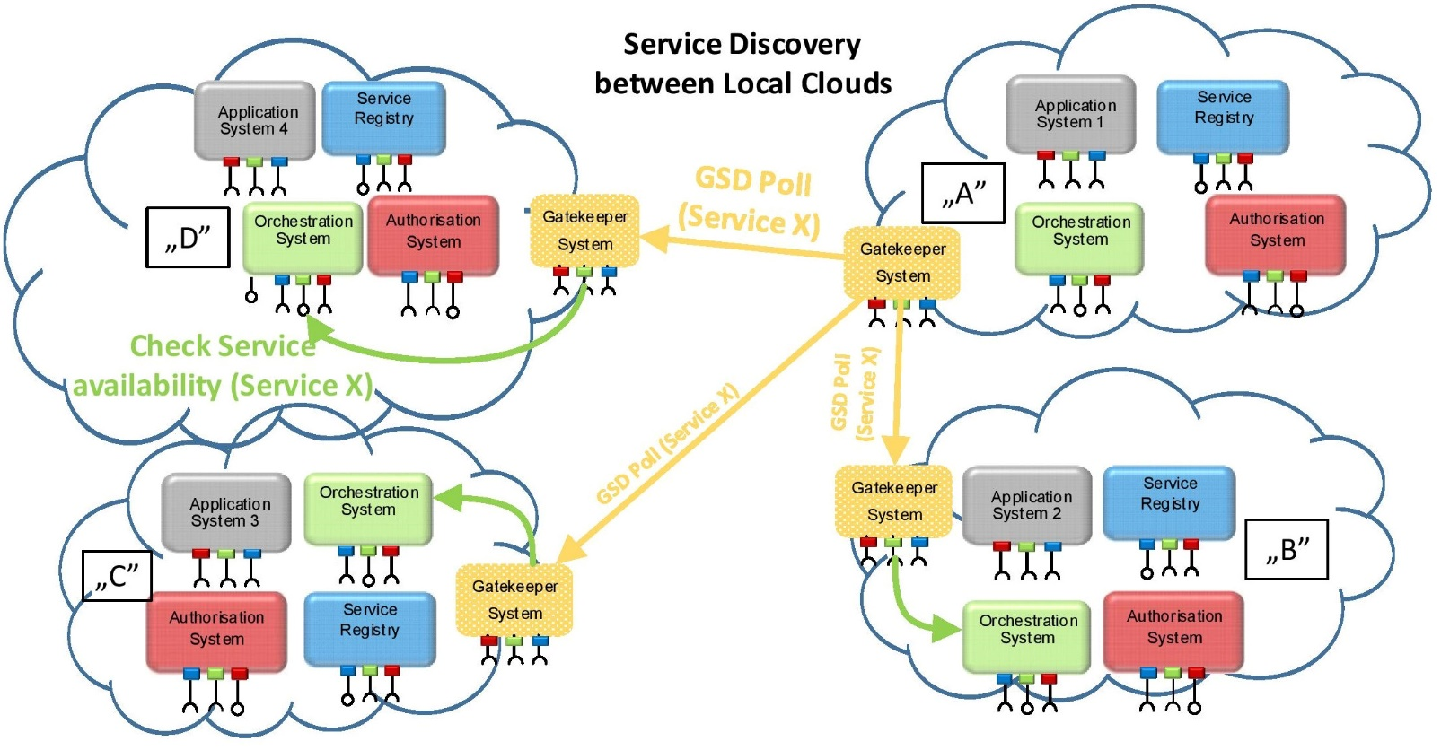
Closed Neighborhoods

Slide 35
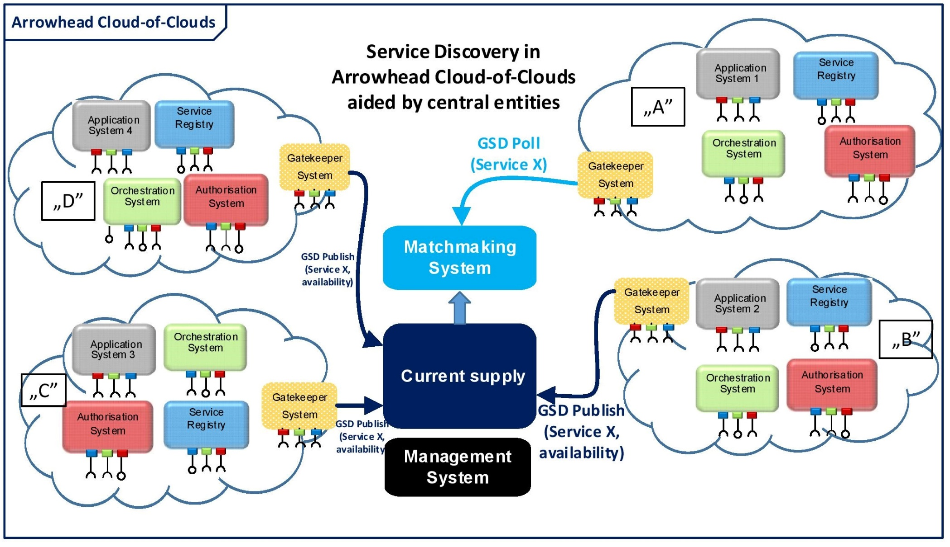
Cloud-of-Clouds

Slide 36
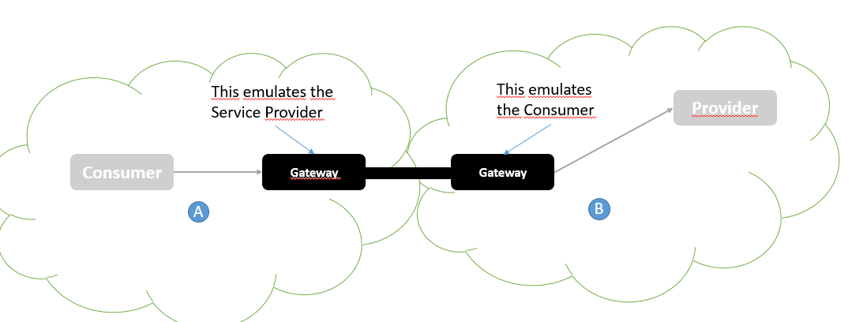
Data path realizations between Clouds
To be release in G3.2 Milestone 3
Utilizes RabbitMQ (AMQP) broker between the gateways
TCP tunneling service between Consumer and Provider
The Gateway is configured by its own Gatekeeper at the end of the inter-Cloud Negotiations process.

Slide 37
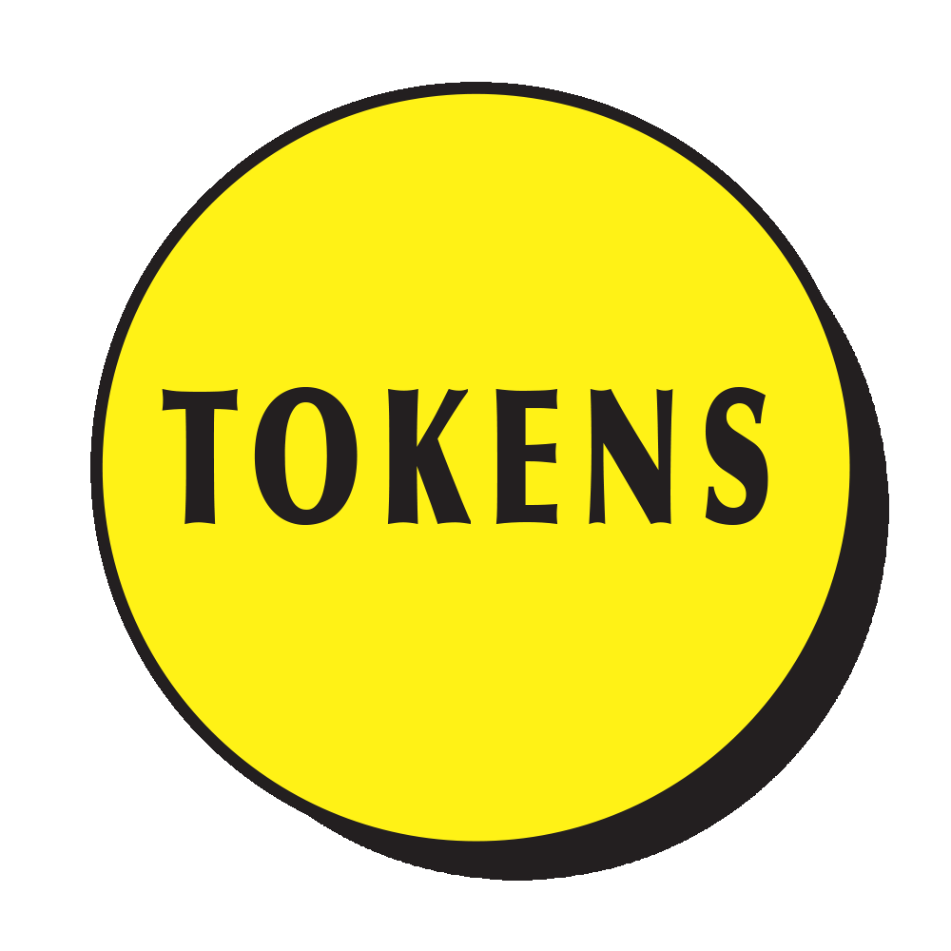
Inter-Cloud orchestration with the token
A
B
Orchestrator
3
4
Orchestrator
1
5
2
Gatekeeper
Gatekeeper
8
Authorization
7
9
7
9
Gateway
Gateway
Service Provider
10
10
10
Consumer

Slide 38
Benefits of this solution
Governance
Intra-Cloud: centralized or decentralized
Inter-Cloud: negotiations between the two Core System sets
Simple Orchestration Service definition
Minimum payload: requester System identification (GET method)
Maximum payload: Consumer preferences, detailed Flags, RequestedQoS, etc.
Protocol independency (should work with MOM-s, e.g. MQTT/AMQP)
Built in multi-level AAA support
Possibility to re-configure SoS
Process engineering
Future work possibility
Builds on the use case defined level of interactions between Core entities
Orchestration is customizable
Can still utilize Orchestration Store, etc.
General guidelines and maximum capability scenario is described here

Slide 39
Future work

Slide 40
Push Orchestration
Utilize the Event Handler, notify every App. System to re-request Orchestration
SOS_CONFIG_CHANGE::ALL_SYSTEMS or ::”SYSTEM_GROUP_NAME” (e.g. only Systems on Production Line #1)
No need to implement Orchestration Push Service, just Event Handler subscribe
SoS_Config_Chg::ProdLine1

Slide 41
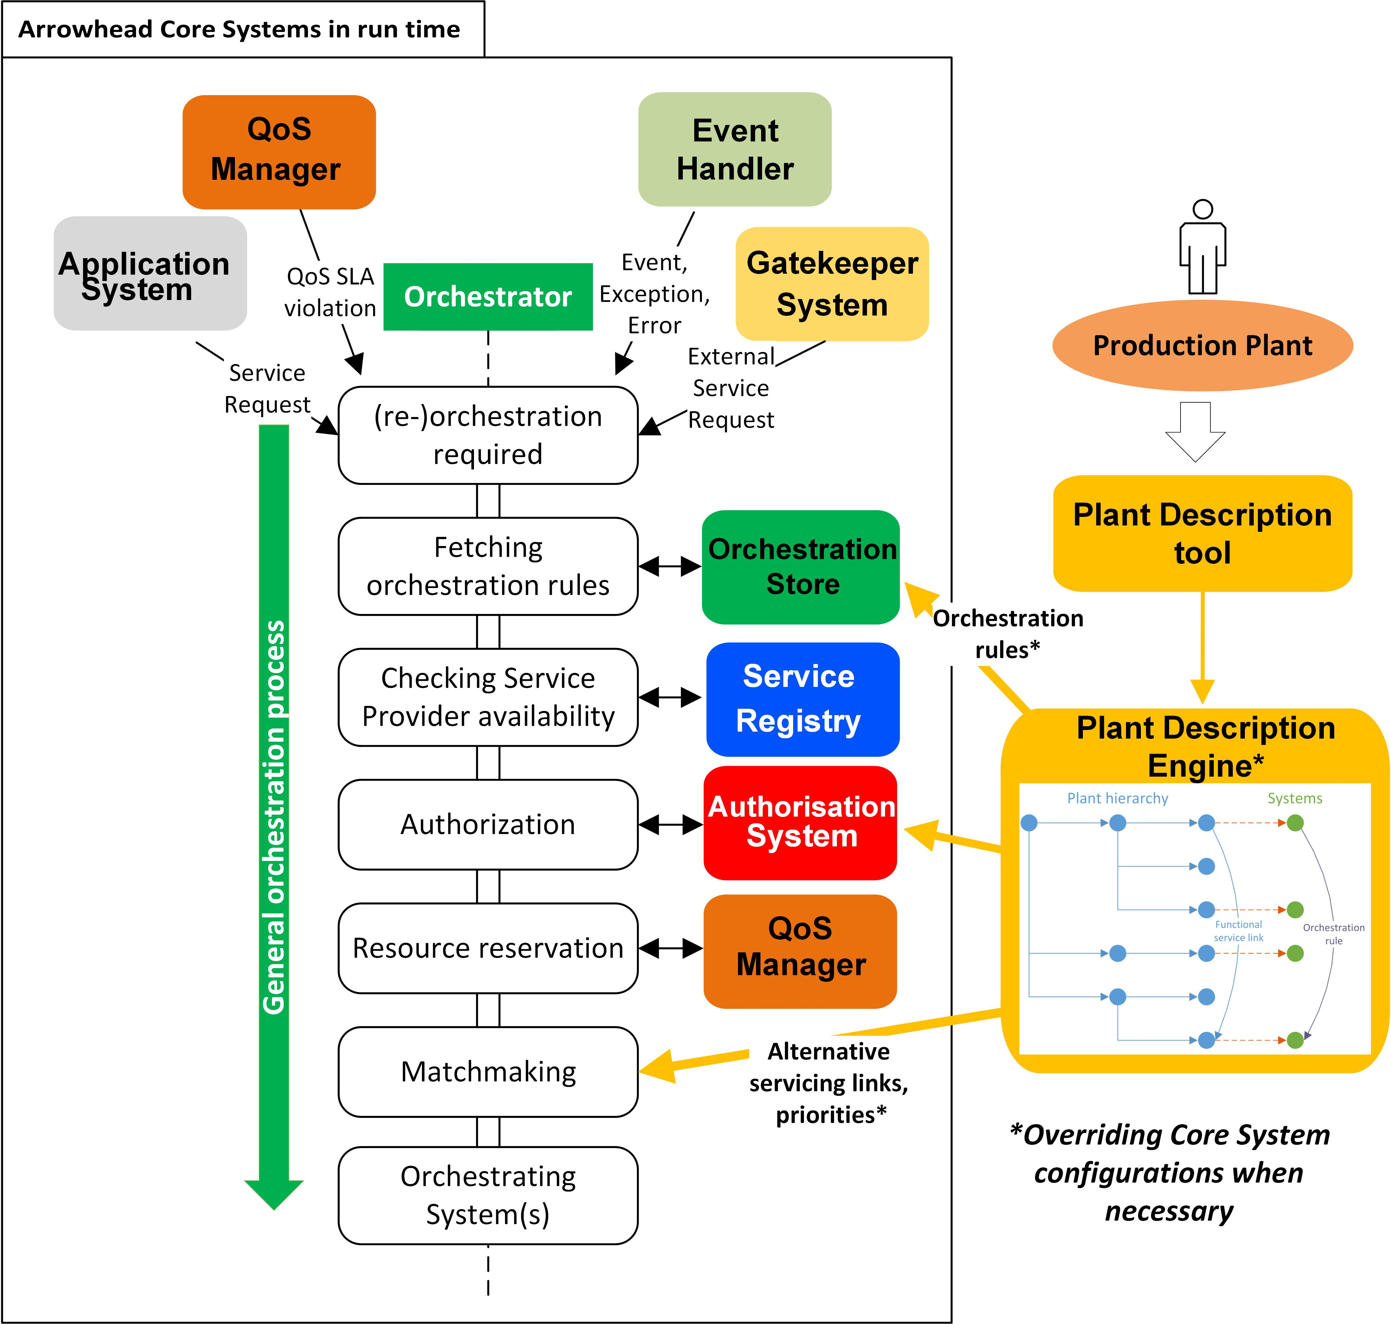
Engineering tools to configure LC / SoS
SoS Configurator entity:
Engineering tool
Utilizes Plant Description, standardized process engineering
Output writes into the core Stores
Orchestration Store
Authorization Store
Gatekeeper settings
Triggers re-orchestration of the SoS
Or parts of the SoS
See article:
Oscar Carlsson, Csaba Hegedűs, Jerker Delsing, Pál Varga: Organizing IoT Systems-of-Systems from Standardized Engineering Data. In Proceedings of IECON 2016, Florence Italy, Oct. 2016.

Slide 42
Engineering results in new SoS configuration
Push configuration
Arrowhead
SoS Choreographer
Plant Description
- functional layout of plant
Processes and systems
„what does what and how”
How the plant, processes and devices are mapped into Arrowhead Systems and Services
Process Flow
Breakdown of the work for Systems
Tasks, quantities, timeliness
Process engineering tools
Trigger re-orchestration
Production/Operation Plan
Operational targets (e.g. 452 cars)
Timeliness and process flows (chassis production then paint it, then…)
„what should do what and how”
Derived from business targets
Service Inventory
Device Registry

Slide 43
Shortcomings / future work
G3.2 implements all of this already
Token generation is integrated in the released version (requires some work)
Event Handler integration is not done
Service Registry Bridge documentation and code cleanup is required (evopro)
Gateway module is conceptual only (TODO)
Should have an interface towards firewall/VPN/Phyiscal relay/etc.
Should be application protocol independent
Should be capable of handling the authorization token
Interoperability between different LC-s and developer groups
A simple DNS-SD naming convention is not enough for inter-Cloud service identification (hence the new Common Descriptor objects)
Arrowhead Service Inventory (need something similar to WS UDDI)
Smarter Service search (e.g. based on detailed descriptions, metadata, etc.)

Slide 44
Shortcomings / future work II.
Authorization System should rely on standards
E.g. RADIUS AAA for access rights tables
Token generation: e.g. OAuth, etc. (having resource constrained in mind)
Handovers and interoperability between different security levels (e.g. if Provider is certificate based, while Consumer is very dumb sensor)
Transaction/servicing level decentralized AAA: blockchains maybe (in one use case)
Process engineering toolset, UI, integration into the Core Framework
Continuation of the plant description work

Slide 45
Requirements engineering concepts for Productive4.0 (SKETCHES)

Slide 46
Deployment environments of the Framework
Based on the known (project) use cases: (sketch)
Production floor scenarios (factory automation)
Real-time QoS, etc.
Across the production chain
Multiple vendors, systems are advanced (ERP, data center, etc.)
AAA is essential, and should be centralized inbetween companies
Market-like scenarios
Virtual market of energy; electromobility
App. Systems enter and leave; servicing is transactional/one-time only
Offered and looked up Services vary over time
The Orchestrator has to provide advanced matchmaking based on a multitude of metadata
Big data, cloud processing, CPS-s, WSN-s, etc.
Like the MANTIS project
Processing entity in the cloud; sensing, actuating, storing locally
Company policies, use case dependent architecture: local and global clouds cooperating

Slide 47
Clusterization of use cases
Digital production
Value chain integration
Logistics
Dimensions:
Application System maturity, autonomy (1-6)
Embedded systems → Fully fledged, no constraints
computation, communication, energy constraints
Local Cloud security expectations (1-5)
No security →Transactional, per servicing level security
Servicing QoS and resource management
Are there real time requirements?
Is there QoS requirement towards the framework?
Data and control handling
Use case specific requirements
Mostly desired, key features of the frameworks

Slide 48
Optimizing for various use cases
Application System capability
Security, AAA
Resource and network QoS management
Data and control handling
X: use cases cluster #1
X
X: use cases cluster#2
X
X
X
X
X
X
X

Slide 49
Optimized versions for various use cases
 | Embedded, streamlined, automation | Fully fledged, value chain integration | Publish-Subscribe, big data
Major target domains | Industrial automation, IIoT, edge processing | Product lifecycle management, supply chain integration, | Big Data collection and processing frameworks, IoT, edge to cloud interfaces
Key features | Streamlined, Store orchestration, event handling, fallback to backup Service Providers, push orchestration, engineering tools, | Scalability of the Core Systems, dynamical and inter-Cloud orchestration, App. System preferences, AAA, logging, web of trust, smart service contracts/ service metadata, protocoltranslation | Lookup, bootstrap, Service Provider metadata, scalability,
Protocols | - CoAP, minimalistic REST, binary UDP, … (SOA request-response) | REST, WS | OPC-UA, MQTT, AMQP, XMPP
To be deployed on | - Edge gateways, smart routers, … - ARM cores with lightweight Linux kernels (Raspberry Pi, OpenWrt) | Cloud infrastructure (private or public) VM servers | On the broker PC Edge gateways, local deployments
Development | One lightweight executable with all mandatory (&support) Core interfaces Modularly compilable („configurable make”, plugins) - C, C++ (Qt) | Java EE, servlet containers System image is needed (iso) | -
Clients | Microcontrollers, sensor motes, actuators, legacy devices with adapters Autonomy level <=3 | Autonomous Application Systems ERP, … Autonomy level > = 3 | Batch and stream processors, distributed databses in the cloud sensor motes, edge gateways
Security levels | intra-Cloud: rarely, primarily a closed network With secure, controlled outgoing link (inter-Cloud) Security level <=3 | Very high expected Blockchains, web of trust solutions should be researched Authorization Store rules should come from contracts, injection of rules with tools | - AAA of the MoM should be extended
Core interfaces | minimalistic, lightweight, maybe binary Should utilize the same protocol as app. services | More complex, flexible, Human readable and debuggable | Depending on target use case Should augment MoM capabilities

Slide 50
Questionnaire for Prod4 WP1 partners
https://goo.gl/forms/C4tZK8ubJYEHHObG2

Slide 51
?
Thank you!

Slide 52
Extending the QoS to service contracts
Network QoS | Core oversight QoS | Application service contract | Service Provider QoS
Latency (E2E) | Orchestration timeout
Packet loss | Re-orchestation required?

